Slide 1
10th Week
Cloud Computing
CE-408
Safia Baloch

Slide 2
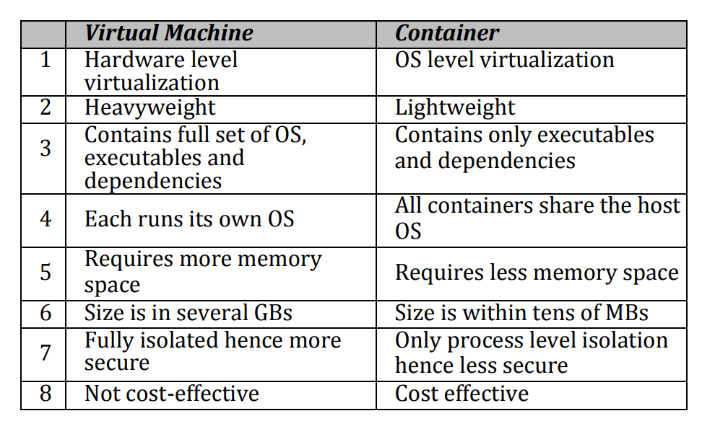
Containers Vs Virtual Machines
What is Virtual machine? What is Container ?

Slide 3
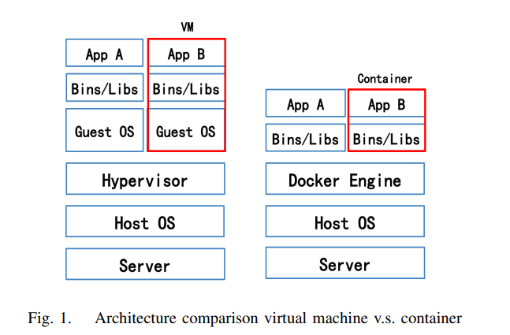
Architecture Comparison

Slide 4
Container (normal Process)
Includes
Application executables
All libraries and dependencies
Features
Cgroups:
namespaces

Slide 5
Differences
What is Virtual machine? What is Container ?
OS (size)
Hypervisor ( Executable Mode)
Image size ( file system)

Slide 6

File Systems
Virtual Machine: vmdk
Container: UnionFS
Restrictions for UFS
Directories in an NFS file system cannot be used in the union file system mount options.
Directories in a union file system cannot be used in the union file system mount options.
The union file system cannot be exported.
The directory that is used in the upper directory can only be used in one union file system.
If any of the underlying file systems of a union file system is unmounted, it will become unusable, and all operations will fail.

Slide 7
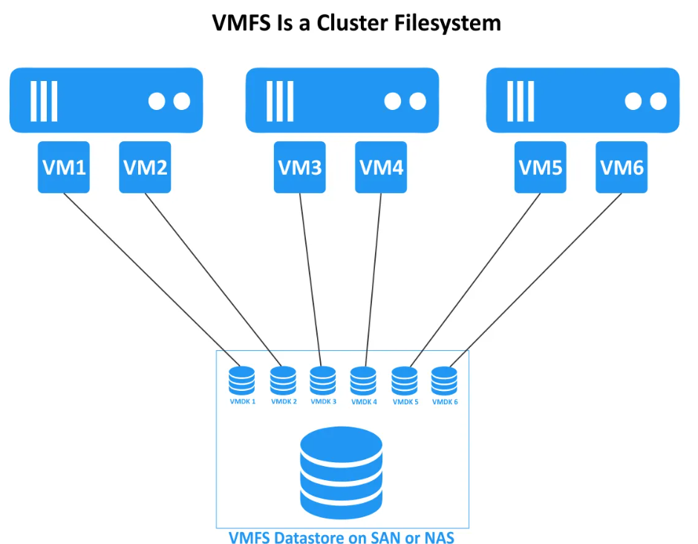
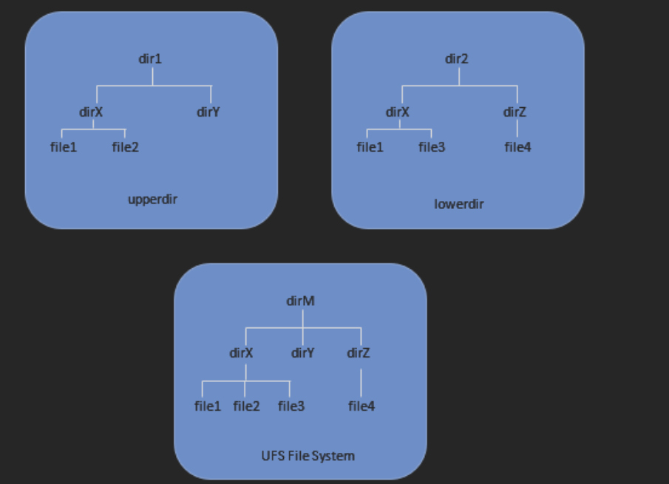

Slide 8
Docker Containerization
Docker, which makes sure that application works in every environment. It also automates the applications that will deploy into Containers. The Docker appends an additional layer of deployment engine over a container environment where the applications are executed and virtualized.

Slide 9
Docker Components
The four main parts of Docker:
Docker Containers
Docker Client-Server
Docker Images
Docker Engine.

Slide 10
Docker Container
Docker container are created by docker image
All service requirements of application are equipped into container image.

Slide 11
Docker Images
Images are generally created by base OS image which are lightweight.
First method: create image from scratch
Once images are created, it needs ?, is called committing a change.
Second method:
Create Docker file which has all information of docker image.
Docker build command will create image with all the dependencies mentioned in a docker file. Is also called automated method of building an image

Slide 12
Docker Engine
a Client-server application which is installed on the host machine with the following components
Docker Daemon: program which create , build, and run application
A Rest API
Client request to docker daemon through terminal to access the operation

Slide 13
Docker Client Server
Client request server ( docker daemon: within host machine)
Server processes: running, building, and distributing containers
Docker container and daemon can be placed in a single machine

Slide 14
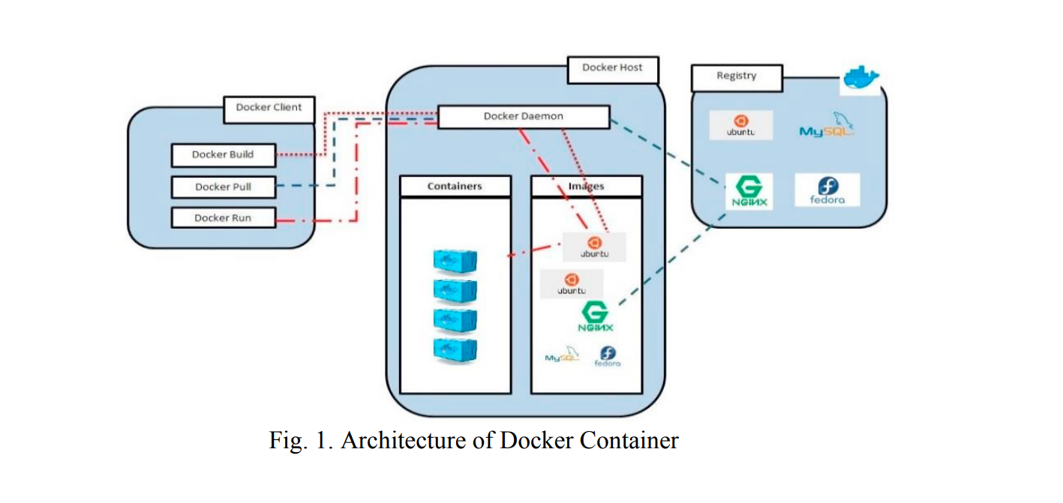
Architecture of Docker Container

Slide 15
Advantages of Docker Container
Easy Deployment: seamlessly moved from one environment to another
Resource Efficiency : many containers deployed on a single host
Portability: encapsulated into single unit, and deployed in various environments without any changes
Rapid Build time: why?
Scalability

Slide 16
LXD: Linux Based Container
Builds on LXC: Linux container, an interface to Linux containerization
LXD use LXC library for low overhead of OS.
LXD also integrate into OpenStack Nova compute component.

Slide 17
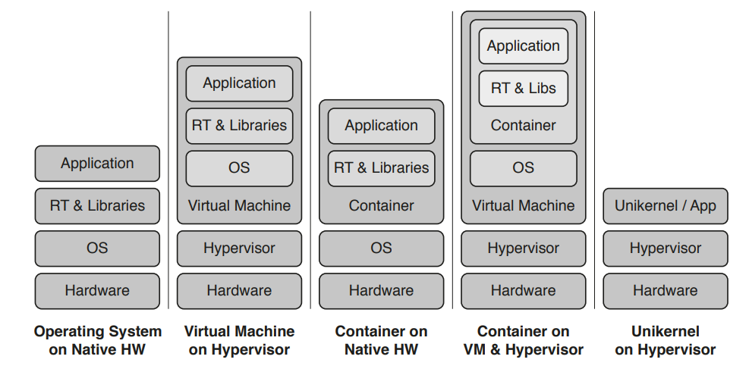
Deployment strategies

Slide 18
Hostel Task: Other than docker container
https://spacelift.io/blog/docker-alternatives
What is Caas? Container as a service

Slide 19
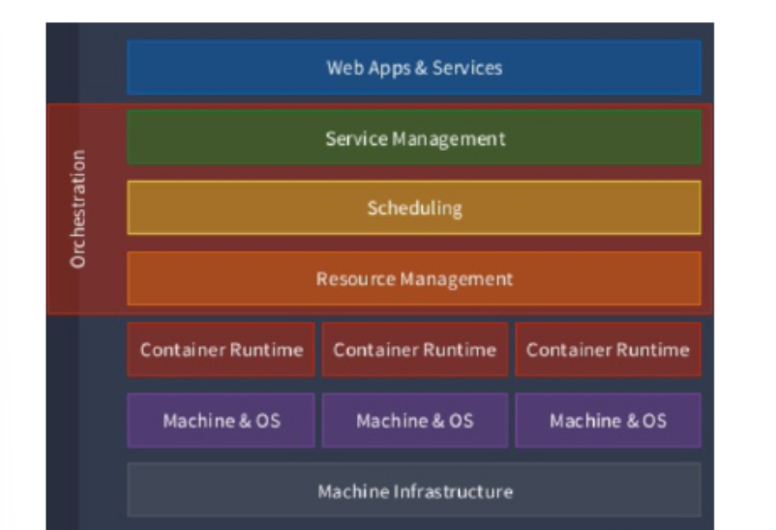
Container Orchestration
Layer | Functional elements
Service Management | Managed low level resources.
Scheduling | Use cluster resources efficiently., placement and replication of containers. Readiness ,rescheduling, rolling deployment etc.
Resource Management | Manage high level aspects, labels- groups/namespace, load balancing

Slide 20
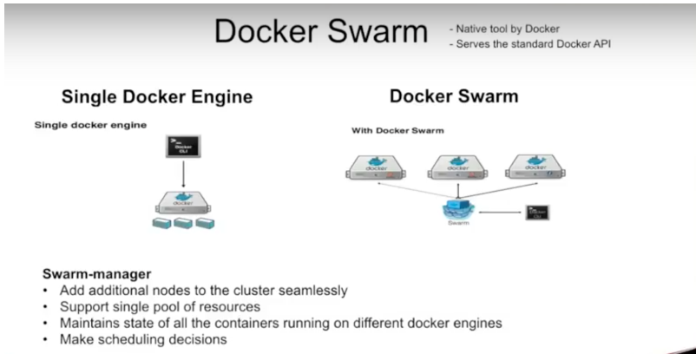
Container Cluster: Docker Swarm

Slide 21
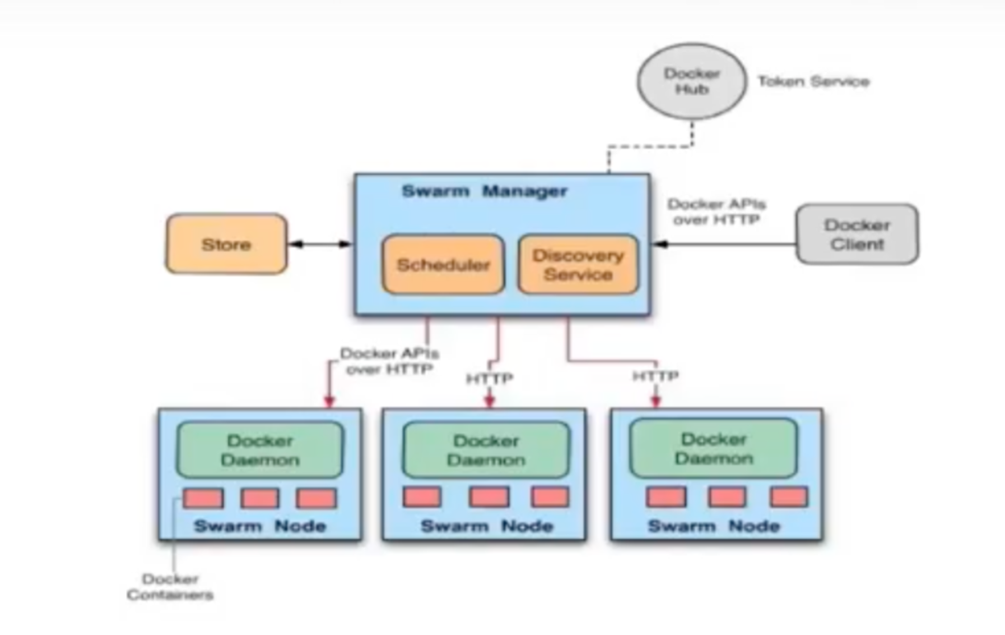

Slide 22
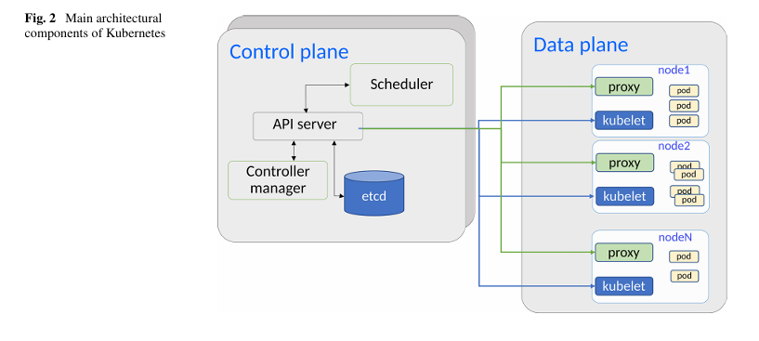
Kubernetes
Etcd: storage component to synchronize the desired state of the master component by watching it. (key , value) pair
Scheduler: maps each pod on a worker nod.
API sever: receive service commands and manipulate the data for Kubernetes objects. (kubtecl)
Controller: monitor etcd and force the system state.

Slide 23
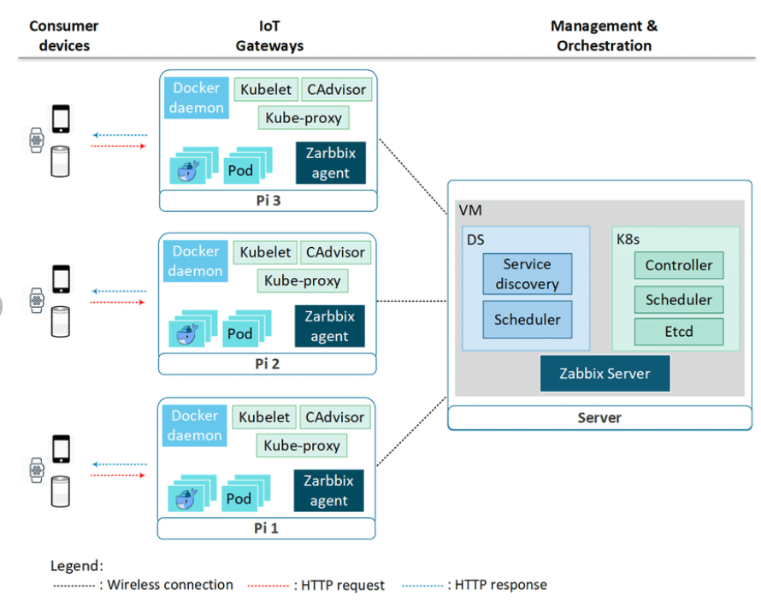

Slide 24
AWS: Elastic Container Services (ECS)

Slide 25
Assignment 2:
Deployment of Model or application on Docker.

